Slide 1

Project Kick-off Meeting
Project: TRAD’ON 2026
Implementation of the CTRM Solution
Prepared by: Valter Marques, SINGA Associates SA
Prepared for: Interacid Trading SA
Date: Thursday, January 22nd 2026

Slide 2
Contents
Project Background and Objectives
Trad’on Solution Overview
Project Preliminary Scope: Phases (Preliminary Execution Plan)
Project Milestones
Data & migration approach (high level)
WIP and Next Steps
Project Organization – Methodology and Stakeholders
Assumptions and Constraints
Meetings Organization
Documents Sharing and Recordings
PM Ground Rules
Project Monitoring and Communication Plan
Contact Details

Slide 3
Background and Objectives
ITSA needs TO REPLACE THE CURRENT CTRM Solution
Key requirements include PERFORMANCE, PROCESS EFFICIENCY, APPLICATION MANAGEMENT, Business Intelligence AND CONTINOUS IMPROVEMENT.
The project DELIVERABLE IS THE trad’on ctrm Solution during q2 2026.

Slide 4
Solution Overview
Foundation
Company & Organization (Legal entities, business units, users, roles)
Master Data Management (Products, counterparties, locations, currencies)
Workflow & Security (User access rights, validations, approvals)
Commodity Trading Core (Trad’on)
Trade Capture (Strategies, Purchase & sales contracts, amendments, confirmations, Initiation)
Contract Lifecycle (From deal capture to final settlement)
Pricing & Exposure (Contract pricing & underlying curves)
Position Management (Physical positions by product, location, period)
Logistics & Operations
Logistics Management (Shipments, deliveries, receipts)
Demurrage Management (Formula & Calculations)
Stock & Inventory (Warehouse, in-transit, ownership tracking)
Linkages and Quality Mgt (Matching, quality attributes)
Operational Costs (Freight, handling, insurance, storage…)
Risk, Hedging & Markets
Market Data (Futures, Indexes, FX rates)
Hedging Instruments (Futures, swaps, internal hedges)
Exposure Monitoring (Price risk, FX risk, mark-to-market)
P&L Analysis (Realized and unrealized P&L)
Reporting, BI & Analytics
Standard Operational Reports (Positions, exposures, P&L)
Accounting & Compliance Reports (Audit files, statutory extracts)
BI & Dashboards (Interactive dashboards, KPIs)
Data Export & Integration (Excel, API, external systems)
Automation & Integration
Business Rules & Automation (Automated postings, workflows)
Interfaces & APIs (Market data, banks, external tools)
Notifications & Controls (Alerts, exceptions, validations)

Slide 5
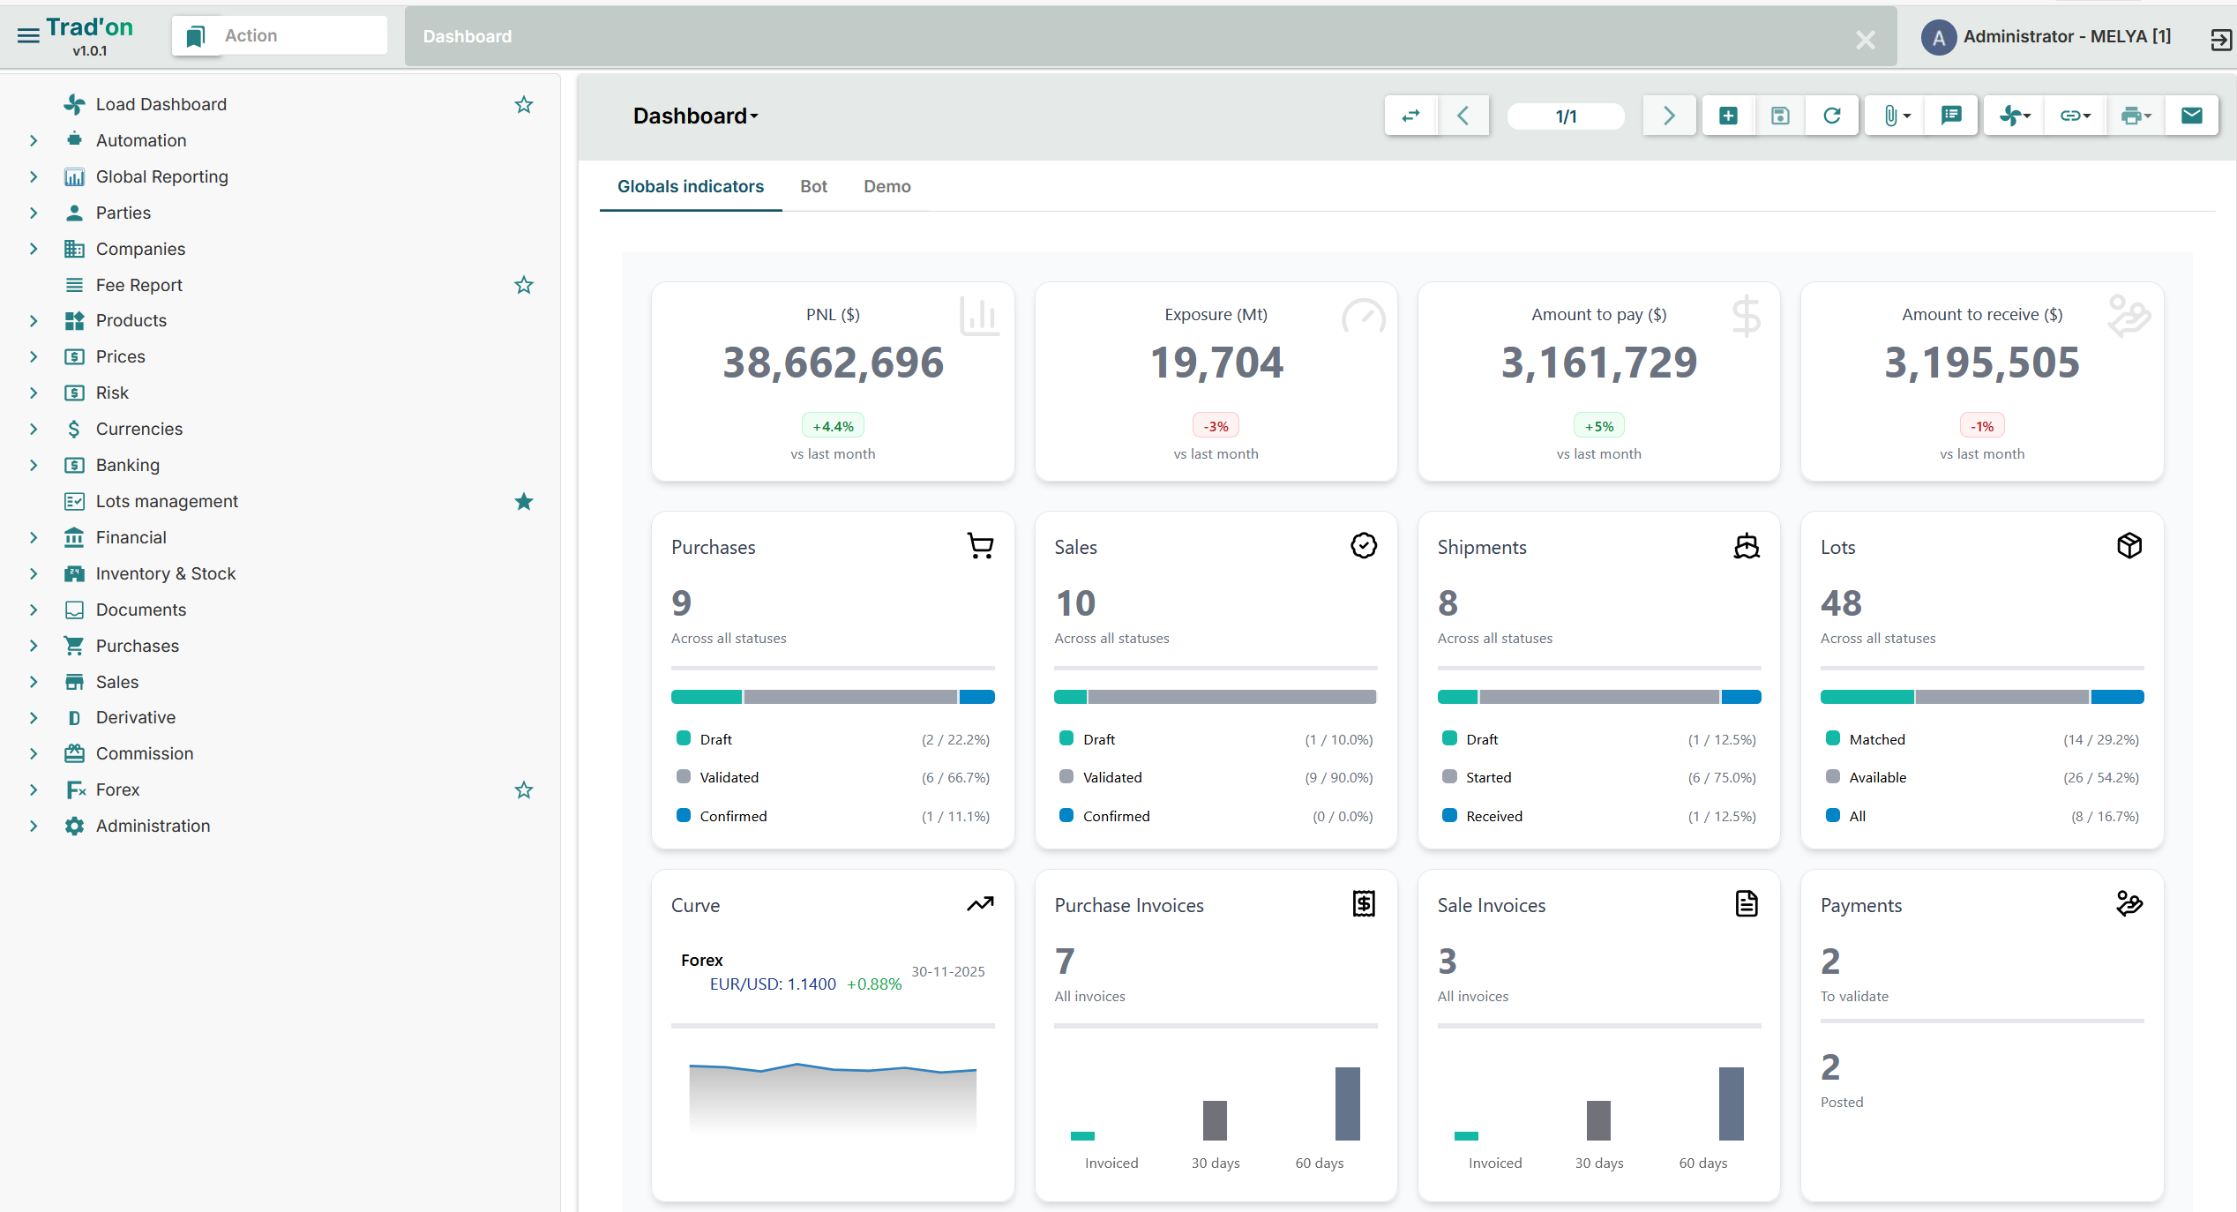
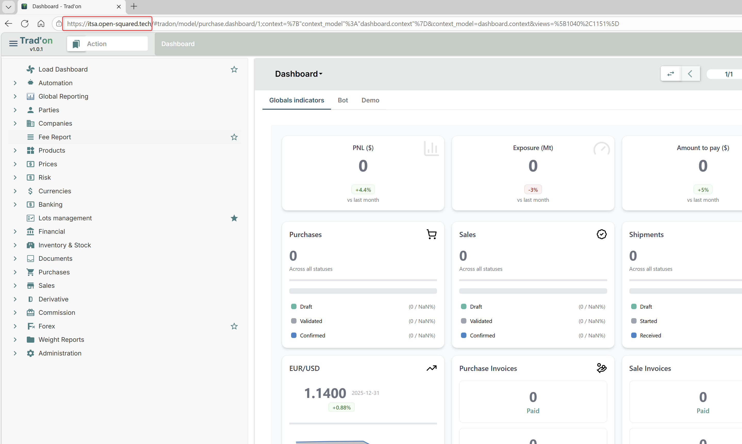
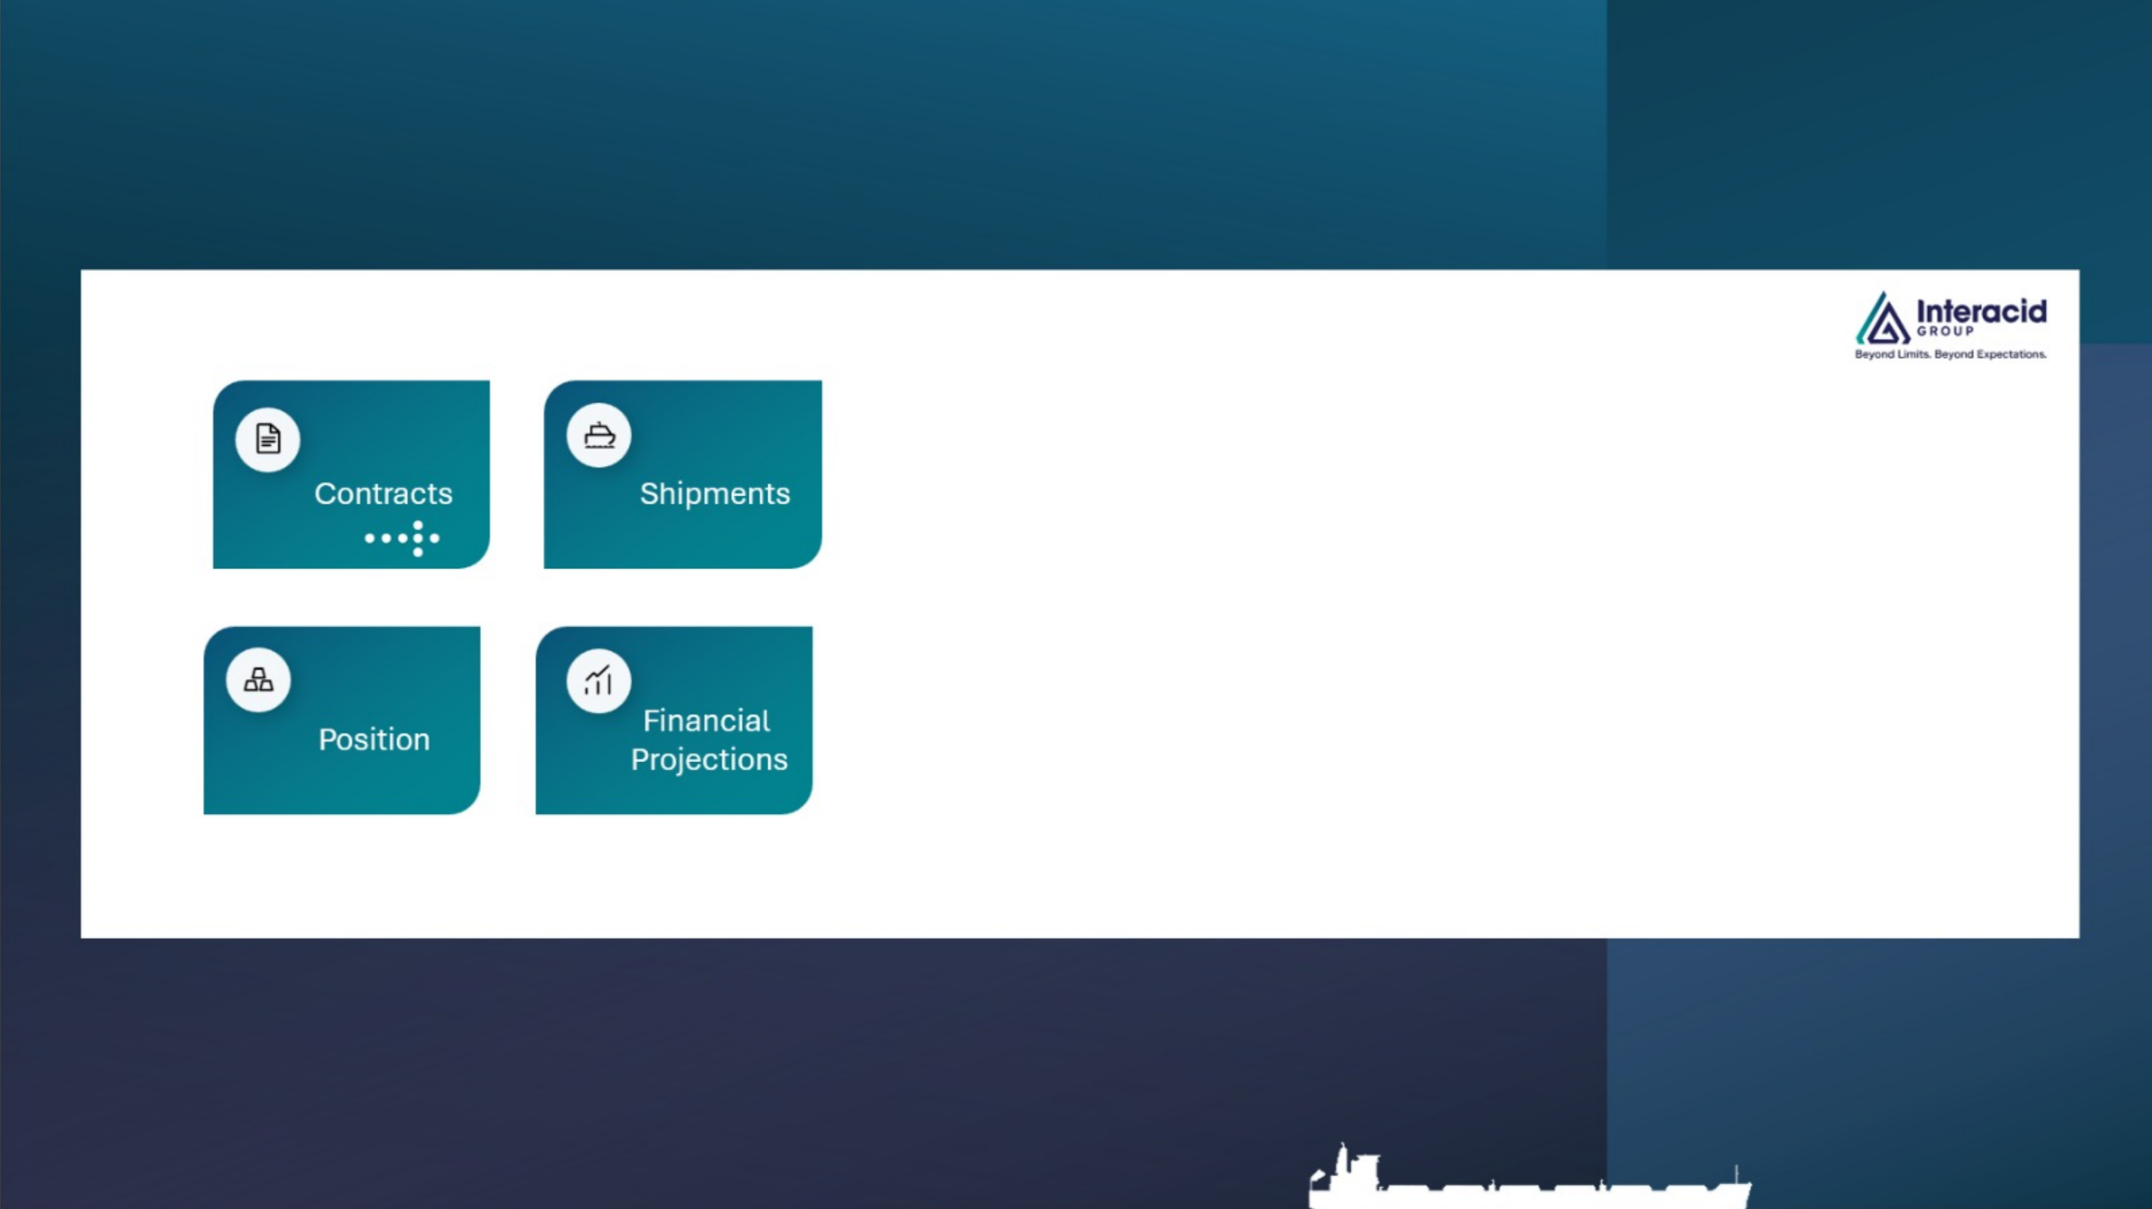
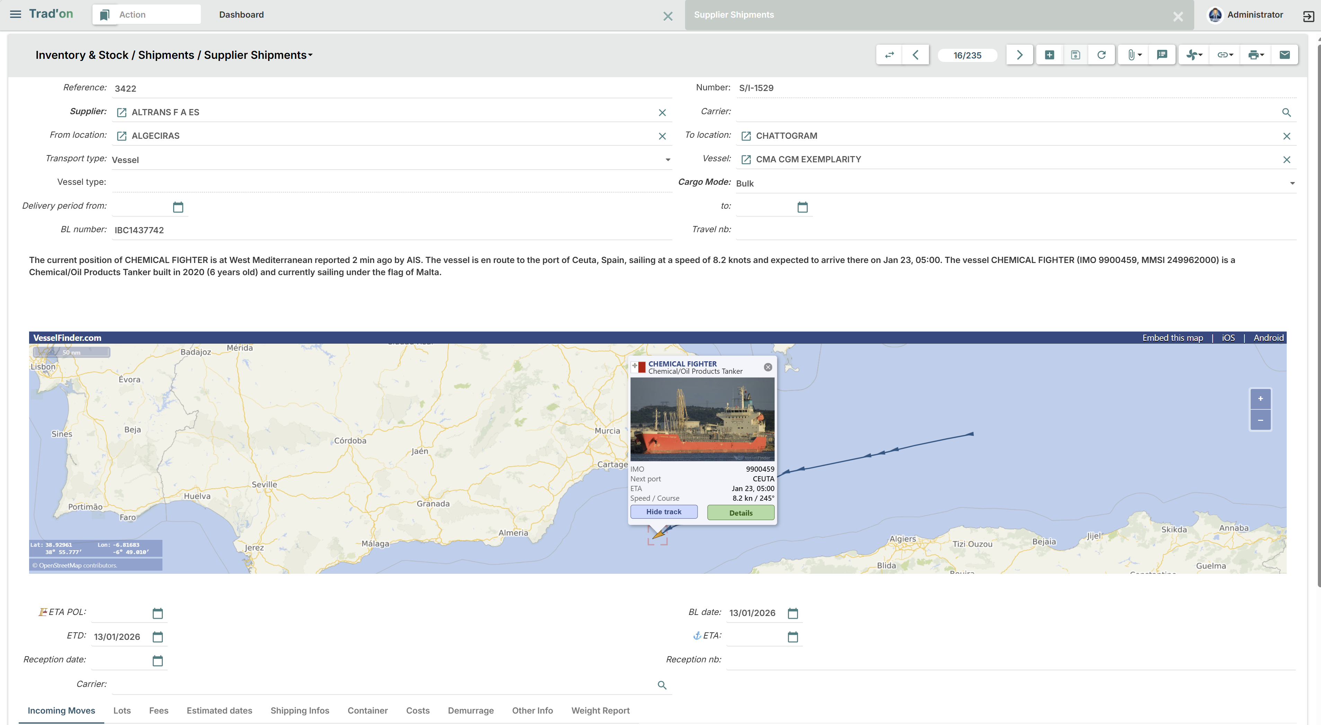
Solution Overview - Tradon and BI Look and Feel

Slide 6


Project Preliminary Scope
Kick-off
Jan Feb Mar April May June
Phase 1 – Reference Data & Layout Foundations
Definition and setup of reference/master data
Legal entities, products, counterparties, currencies
Accounting structure validation
Preparation of document layouts and templates
(contracts, confirmations, invoices, operational docs)
Deliverable: Validated reference data & document templates
Phase 2 – Business Scenarios & Scope Confirmation
Selection of representative business scenarios
End-to-end process walkthroughs
Functional coverage validation
Identification of out-of-scope items
Deliverable: Confirmed business scenarios & functional perimeter
Phase 3 – GAP Analysis & Solution Design
GAP analysis against TRAD’ON standard
Functional and technical design of required adaptations
Prioritization of gaps (must-have vs nice-to-have)
Deliverable: GAP analysis & solution design document
Phase 4 – Configuration & Customization
System configuration
Development of agreed customizations
Initial integration setup (if applicable)
Deliverable: Configured and customized TRAD’ON environment
Phase 5 – Test Iterations
Internal testing
Iterative functional testing with key users
Fixes and adjustments
Deliverable: Tested and stabilized solution
Phase 6 – User Acceptance Testing (UAT)
UAT preparation and scenarios
Execution of UAT with business users
Formal acceptance and sign-off
Deliverable: UAT sign-off
Phase 7 – Training & Knowledge Transfer
Key user training
End-user training sessions
Documentation and operating procedures
Deliverable: Trained users & training materials
Phase 8 – Data Migration
Migration strategy and scope
Test migrations
Final data migration
Deliverable: Production-ready data set
Phase 9 – Parallel Run & Go-Live Readiness
Parallel run with legacy systems
Validation of results
Go-Live readiness review
Formal green light to Go-Live
Deliverable: Go-Live approval
Phase 10 – Go-Live
Production Go-Live
Monitoring of initial operations
Deliverable: TRAD’ON live in production
Phase 11 – Hypercare & Project Closure
Hypercare support period
Issue resolution and stabilization
Formal project closure
Deliverable: Stable operations & project closure report
Phase 12 – Support & Continuous Improvement
Transition to support mode
Continuous improvements and enhancements
Roadmap refinement
Deliverable: Support governance & improvement roadmap

Slide 7

Project Milestones
Kick-off
Go Live
Go Live: 31.05.2026
Close and Hypercare: June
Kick-off Meeting: 26.01.2026
GAP List : 28.02.2026
Customizations: 15.04.2026
UAT Testing 30.04.2026
Data Migration 15.05.2026

Slide 8
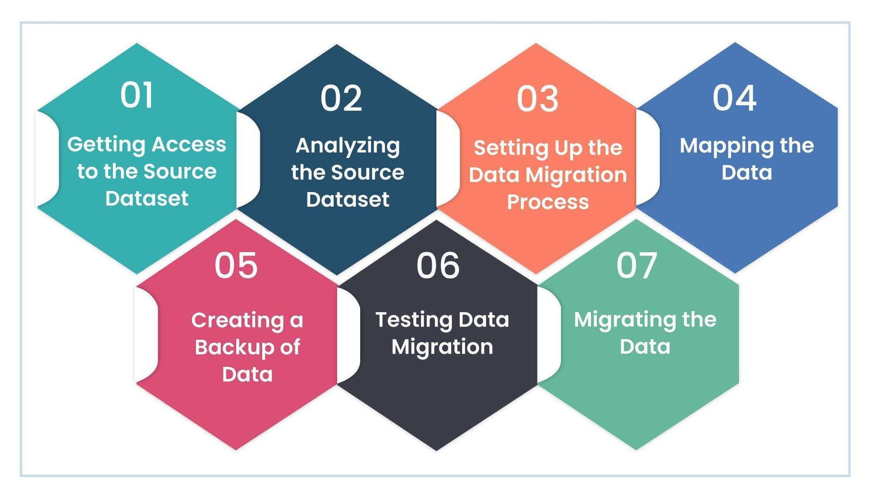
Data Migration Approach
Business Approach
Technical Approach
Migrate Reference Data (early)
Use Reference Data for actual scenarios testing and validation
Determine Migration Scope:
  Open Position
  Last 3 years
  etc
Prepare extraction
Validate Data
Current work in progress: Step 1, starting Step 2

Slide 9
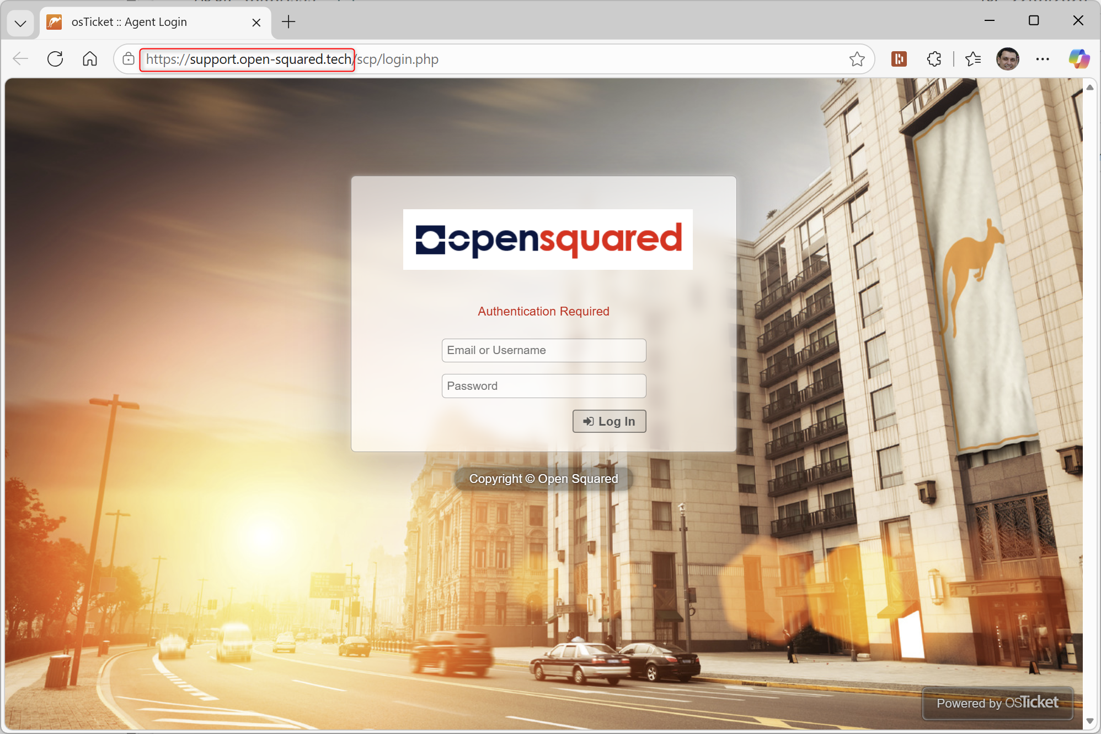
WIP and Next Steps
Infrastructure and Hosting of Tradon
https://itsa.open-squared.tech
Customer Portal (ticketing)
https://support.open-squared.tech
BI Solution: Modeling
Major Next Implementation Step:
Business Landscape (Site survey)
Business Scenarios selection

Slide 10

Project Organization – Methodology and Stakeholders
Project Methodology: Based on PMI best practices
Project Sponsor: MUSE Jean-François
Project Management Team
SINGA/OS: MARQUES Valter
ITSA: ZACCARINI Stève
Subject Matter Experts
General PM Monitoring and Business Contact: Jean-François/Stève
Trade: Jérémie/Stéphane/Shi-Han
Finance: Stève/Javier
Accounting and future interface with BC: Javier/Stève
Operations and Logistics: Gregory/Oliver/Angela
Demurrage: Grégory/Olivier
IT/Infrastructure: Cyber Network/Javier/Shi-Han
Compliance/Legal: Jean-François/Stève

Slide 11
Assumptions and Constraints
Assumptions:
SME will be available during the project implementation (10-20% workload)
All project team members will manage project activities efficiently
Processes and workflows are stable
Constraints:
Time constraints related to business workload
Advance notice for attendance or delivery issues
Use of personal devices and adherence to meeting etiquette

Slide 12
Meetings Organization
Audience:
Remote meetings using Teams
Preparation:
Clear objectives and agenda
Updated schedules in Outlook to avoid conflicts

Slide 13
Documents Sharing and Recordings
Use of a dedicated documentation portal
(current solution being selected/implemented by Open Squared)
Meetings can be recorded for review and further sharing with ITSA Team members

Slide 14
Project Ground Rules
Language:
Meetings
Project Activities
Workshops and Demos
Communication (written, verbal)
Project deliverables
Will all be done in the English language
French language shall be used when 100% of the audience speaks French and there is no need to reuse the contents of the meeting (i.e. Training, Meeting Recording to extra audience, ….)
Rules:
No parallel communication to avoid redundancy and miscoordination of activities. Please coordinate all issues with the Project Management Team.
Feel free to speak up, during and before/after the Workshops with the Project Management Team, however, everyone involved must stick to the subject and avoid side-conversations.
Meeting notes are taken by a pre-designed participant/digital assistant in case of need.
Terminology:
Ask questions about functionalities, terminology or terms used for which you are not familiar with. There are no stupid questions, open-up your concerns so things are cleared faster.

Slide 15
Communication Plan
Project Management software (Plane) will be used to share status of the project with ITSA Project Team members.
A weekly Project Management meeting will be held. The Project Management team will verbally report the status of the project, its progress, its alignment with the budget and ask for advice/decision on any issue that might be occurring.

Slide 16
SINGA & OPEN SQUARED Contacts
MARQUES Valter | v.marques@singa-associates.com |  | +41 79 816 91 06 | PM/Business Analyst
DUVERNAY Sylvain | s.duvernay@singa-associates.com |  | +41 79 258 06 52 | BI/Business Analyst
BARONTINI Laurent | l.barontini@open-squared.com
OGI Mélanie | m.ogi@singa-associates.com | +41 22 335 62 68 | +41 78 692 24 18 | Project Coordinator

Slide 17

Thank you for your attention

